Slide 1
Introduction
Pollacia’s Chapter 01

Slide 2
Why Oracle?
Oracle is the Market Leader: Oracle is the preeminent data management platform in use throughout the world today
Microsoft considered #1 software maker in the world
Oracle is considered #2 software maker in the world
IBM DB2 is also competitor
99 of top 100 revenue-generating web sites are built on the Oracle RDBMS
Notes:
Oracle Database 11g: SQL Fundamentals I I - <number>

Slide 3

Oracle Database 11g: Grid Computing
  GRID: Means always available, like the electrical grid. Think of the utilities, such as electrical or water. It’s always there, on-demand when you need it.
Notes:
Oracle Database 11g: SQL Fundamentals I I - <number>
Oracle Database 11g: Grid Computing

Slide 4
Oracle Database 11g: Main Components
Database
Application
Server
Enterprise
Manager
Application
Development
Tools
    Oracle database: this is a multi-user, large-scale database.
    Application Server: Platform for developing and running client/server or web applications.
    Enterprise Manager: Management, monitoring, and administration for a large-scale system.
    Application Development Tools: PL/SQL, J2EE, Oracle Forms Developer, Oracle Reports Developer
Notes:
Oracle Database 11g: SQL Fundamentals I I - <number>
Oracle Database 11g: Grid Computing

Slide 5
Features of Oracle Database 11g
No limits on number of tables
No limits on size of tables
Can directly execute SQL, PL/SQL, and Java
Interfaces to other 3rd-party lanagues
Notes:
Oracle Database 11g: SQL Fundamentals I I - <number>
Oracle Database 11g
Organizations need to support multiple terabytes of information for users who demand fast and secure access to business applications round-the-clock. The database systems must be reliable and must be able to recover quickly in the event of any kind of failure. Oracle Database 11g is designed along the following feature areas to help organizations manage infrastructure grids easily and deliver high-quality service:
Manageability: By using some of the change assurance, management automation, and fault diagnostics features, the database administrators (DBAs) can increase their productivity, reduce costs, minimize errors, and maximize quality of service. Some of the useful features that promote better management are Database Replay facility, the SQL Performance Analyzer, and the Automatic SQL Tuning facility.
High availability: By using the high availability features, you can reduce the risk of down time and data loss. These features improves online operations and enable faster database upgrades.

Slide 6
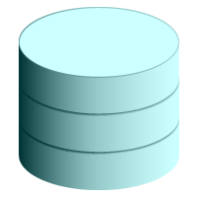

Relational Database Model
  Dr. E. F. Codd proposed the relational model for database systems in 1970.
  It is the basis for the relational database management system (RDBMS).
  The relational model consists of the following:
    Collection of tables (relations)
    Set of operators to act on the relations (relational algebra)
    Data integrity for accuracy and consistency
    Primary and foreign keys
Notes:
Oracle Database 11g: SQL Fundamentals I I - <number>
Relational Database Concept
The principles of the relational model were first outlined by Dr. E. F. Codd in a June 1970 paper titled “A Relational Model of Data for Large Shared Data Banks.” In this paper, Dr. Codd proposed the relational model for database systems.
The common models used at that time were hierarchical and network, or even simple flat-file data structures. Relational database management systems (RDBMS) soon became very popular, especially for their ease of use and flexibility in structure. In addition, a number of innovative vendors, such as Oracle, supplemented the RDBMS with a suite of powerful, application development and user-interface products, thereby providing a total solution.
Components of the Relational Model
Collections of objects or relations that store the data
A set of operators that can act on the relations to produce other relations
Data integrity for accuracy and consistency
For more information, see An Introduction to Database Systems, Eighth Edition (Addison-Wesley: 2004), written by Chris Date.

Slide 7


Definition of a Relational Database
A relational database is a collection of relations or
two-dimensional tables.
Oracle
server
Table name: EMPLOYEES
Table name: DEPARTMENTS
…
…
Notes:
Oracle Database 11g: SQL Fundamentals I I - <number>
Definition of a Relational Database
A relational database uses relations or two-dimensional tables to store information.
For example, you might want to store information about all the employees in your company. In a relational database, you create several tables to store different pieces of information about your employees, such as an employee table, a department table, and a salary table.

Slide 8
Entity Relationship Model
EMPLOYEE
#* number
* name
o job title
DEPARTMENT
#* number
* name
o location
assigned to
composed of
  Scenario:
    “. . . Assign one or more employees to a
    department . . .”
    “. . . Some departments do not yet have assigned employees
    . . .”
Notes:
Oracle Database 11g: SQL Fundamentals I I - <number>
Entity Relationship Model
An entity relationship (ER) model is an illustration of the various entities in a business and the relationships among them.
Benefits of ER Modeling:
Documents information for the organization in a clear, precise format
Provides a clear picture of the scope of the information requirement
Provides an easily understood pictorial map for database design
Offers an effective framework for integrating multiple applications
Key Components
Entity: An aspect of significance about which information must be known. Examples are departments, employees, and orders.
Attribute: Something that describes or qualifies an entity. For example, for the employee entity, the attributes would be the employee number, name, job title, hire date, department number, and so on. Each of the attributes is either required or optional. This state is called optionality.
Relationship: A named association between entities showing optionality and degree. Examples are employees and departments, and orders and items.

Slide 9
Entity Relationship
Modeling Conventions
Entity:
  Singular, unique name
  Uppercase
  Soft box
  Synonym in parentheses
Attribute:
  Singular name
  Lowercase
  Mandatory marked with “*”
  Optional marked with “o”
EMPLOYEE
#* number
* name
o job title
DEPARTMENT
#* number
* name
o location
assigned to
composed of
Unique Identifier (UID)
Primary marked with “#”
Notes:
Oracle Database 11g: SQL Fundamentals I I - <number>
ER Modeling Conventions
Entities
To represent an entity in a model, use the following conventions:
Singular, unique entity name
Entity name in uppercase
Soft box
Optional synonym names in uppercase within parentheses: ( )
Attributes
To represent an attribute in a model, use the following conventions:
Singular name in lowercase
Asterisk (*) tag for mandatory attributes (that is, values that must be known)
Letter “o” tag for optional attributes (that is, values that may be known)
Relationships

Slide 10
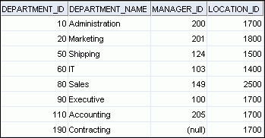
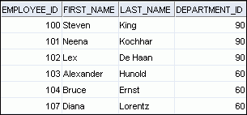
Relating Multiple Tables
  Each row of data in a table is uniquely identified by a primary key.
  You can logically relate data from multiple tables using foreign keys.
Table name: DEPARTMENTS
Table name: EMPLOYEES
…
Primary key
Foreign key
Primary key
Notes:
Oracle Database 11g: SQL Fundamentals I I - <number>
Relating Multiple Tables
Tables are related through the use of Primary and Foreign keys.
A Primary key is a unique identifier for each row, which cannot be NULL.
A foreign key is a column in a different table (a “foreign” table) where every value must match one of the related primary key values (or it could be NULL.)

Slide 11
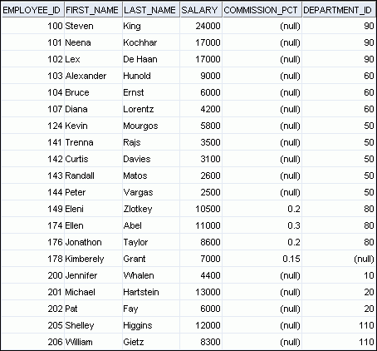
Relational Database Terminology
3
2
4
5
6
1
Notes:
Oracle Database 11g: SQL Fundamentals I I - <number>
Relational Database Terminology
The numbers indicate the following:
1. A single row (or tuple) representing all the data required for a particular employee. The order of rows is insignificant; specify the row order when the data is retrieved.
2. A primay key column or attribute containing the employee number. A primary key must contain a unique value and cannot be NULL.
A column that is not a key value.
4. A column containing the department number, which is also a foreign key. A foreign key refers to a primary key or a unique key in the same table or in another table. In the example, DEPARTMENT_ID uniquely identifies a department in the DEPARTMENTS table.
5. A field can be found at the intersection of a row and a column. There can be only one value in it.
6. A field may have no value in it. This is called a null value. In the EMPLOYEES table, only those employees who have the role of sales representative have a value in the COMMISSION_PCT (commission) field.

Slide 12
Generations of Languages
SQL is most widely used, and most successful 4GL
Generations of languages:
  1GL -- machine code
  2GL – assembly language
  3GL – procedural languages (Java, C#, PHP, etc.)
  4GL – programmer doesn’t have to give the procedure, closer to human language
    SQL
    Artificial intelligence languages
Notes:
Oracle Database 11g: SQL Fundamentals I I - <number>

Slide 13
Oracle SQL vs ANSI SQL
ANSI SQL is SQL:2003
Adopted by:
  ANSI – American National Standards Institute (Washington, D.C.)
  ISO – International Standards Organization (Geneva)
Oracle is ANSI-compliant, so it will run standard SQL
(but it has some additional features, so it’s not identical to standard)
Notes:
SQL statements supported by Oracle comply with industry standards.
Oracle Corporation ensures future compliance with evolving standards by actively involving key personnel in SQL standards committees. The industry-accepted committees are ANSI and International Standards Organization (ISO). Both ANSI and ISO have accepted SQL as the standard language for relational databases.
Oracle Database 11g: SQL Fundamentals I I - <number>

Slide 14
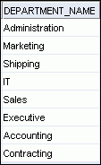
Using SQL to Query Your Database
Structured query language (SQL) is:
  A set—oriented language
    It operates on a set of rows with one command
    You tell the server what you want, but not how to get it
SELECT department_name
FROM departments;
Oracle
server
Notes:
Oracle Database 11g: SQL Fundamentals I I - <number>
Using SQL to Query Your Database
In a relational database, you do not specify the procedure to access the tables, you just specify what you want.
To access the database, you execute a structured query language (SQL) statement, which is the American National Standards Institute (ANSI) standard language for operating relational databases. SQL is a set of statements with which all programs and users access data in an Oracle database. Application programs and Oracle tools often allow users access to the database without using SQL directly, but these applications, in turn, must use SQL when executing the user’s request.
SQL provides statements for a variety of tasks, including:
Querying data
Inserting, updating, and deleting rows in a table
Creating, replacing, altering, and dropping objects
Controlling access to the database and its objects
Guaranteeing database consistency and integrity
SQL unifies all of the preceding tasks in one consistent language and enables you to work with data at a logical level.

Slide 15
16 SQL Statements, in 4 categories
SELECT
INSERT
UPDATE
DELETE
MERGE
CREATE
ALTER
DROP
RENAME
TRUNCATE
COMMENT
GRANT
REVOKE
COMMIT
ROLLBACK
SAVEPOINT
Data manipulation language (DML)
Data definition language (DDL)
Data control language (DCL)
Transaction control
Notes:
Oracle Database 11g: SQL Fundamentals I I - <number>
DON’T BE FOOLED BY THE SIMPLE-LOOKING STATEMENTS!!
In practice, SQL coding can be very easy, but it also can be very complicated.

Slide 16
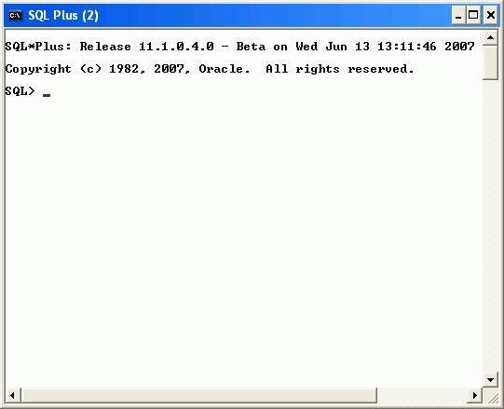
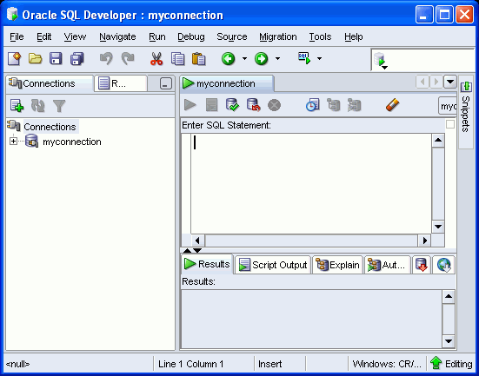
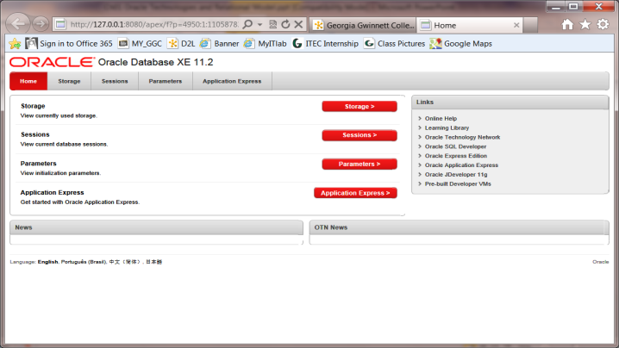
3 Development Environments for SQL
  SQL*Plus (command line)
  Oracle SQL Developer (GUI)
  Application Express (web-based)
SQL *Plus
SQL Developer
App Express
Notes:
Oracle Database 11g: SQL Fundamentals I I - <number>
Development Environments for SQL
SQL Developer
This course has been developed using Oracle SQL Developer as the tool for running the SQL statements discussed in the examples in the slide and the practices.
SQL Developer version 1.2 is shipped with Oracle Database 11g, but newer versions should be downloaded.
SQL*Plus
The SQL*Plus environment may also be used to run all SQL commands covered in this course.

Slide 17
The Human Resources (HR) Schema
DEPARTMENTS
department_id
department_name
manager_id
location_id
LOCATIONS
location_id
street_address
postal_code
city
state_province
country_id
JOB_HISTORY
employee_id
start_date
end_date
job_id
department_id
EMPLOYEES
employee_id
first_name
last_name
email
phone_number
hire_date
job_id
salary
commission_pct
manager_id
department_id
COUNTRIES
country_id
country_name
region_id
JOBS
job_id
job_title
min_salary
max_salary
REGIONS
region_id
region_name
Notes:
Oracle Database 11g: SQL Fundamentals I I - <number>
The Human Resources (HR)Schema Description
The Human Resources (HR) schema is a part of the Oracle Sample Schemas that can be installed in an Oracle database. The practice sessions in this course use data from the HR schema.
Table Descriptions
REGIONS contains rows that represent a region such as America, Asia, and so on.
COUNTRIES contains rows for countries, each of which is associated with a region.
LOCATIONS contains the specific address of a specific office, warehouse, or production site of a company in a particular country.
DEPARTMENTS shows details about the departments in which the employees work. Each department may have a relationship representing the department manager in the EMPLOYEES table.
EMPLOYEES contains details about each employee working for a department. Some employees may not be assigned to any department.
JOBS contains the job types that can be held by each employee.
JOB_HISTORY contains the job history of the employees. If an employee changes departments within a job or changes jobs within a department, then a new row is inserted into this table with the earlier job information of the employee.

Slide 18
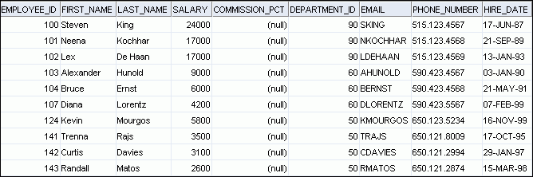
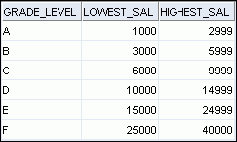
Tables Used in the Course
EMPLOYEES
DEPARTMENTS
JOB_GRADES
Notes:
Oracle Database 11g: SQL Fundamentals I I - <number>
Tables Used in the Course
The following main tables are used in this course:
EMPLOYEES table: Gives details of all the employees
DEPARTMENTS table: Gives details of all the departments
JOB_GRADES table: Gives details of salaries for various grades
Apart from these tables, you will also use the other tables listed in the previous slide such as the LOCATIONS and the JOB_HISTORY table.
Note: The structure and data for all the tables are provided in Appendix B.

Slide 19
Oracle Certification Programs
OCA – Oracle Certified Associate
OCP – Oracle Certificed Professional
OCM – Oracle Certified Master
051 (SQL 1) + 052 (DB 1)
OCA + 1 training + 053 (DB 2)
OCP + 2 training + 2-day Master Exam (rigorous/performance-based)
051 is the exam you will be studying to take in this class

